Slide 1


Twitter Heron : Stream Processing at Scale
~Arshita Sharma ~Richa Patel ~Harish Reddy

Slide 2
Introduction
Did you know?
In today's digital age, the volume of data generated every minute is equivalent to 4.5 million YouTube videos, 500,000 tweets, and 3.5 million Google searches. Processing and analyzing this massive amount of data in real-time presents significant challenges for large-scale environments. How can organizations effectively handle this deluge of data and derive valuable insights from it?
Twitter Heron
Twitter Heron is a real-time, distributed stream processing system developed by Twitter to tackle these data processing challenges at scale. In this presentation, we will explore the motivation behind Twitter Heron, its architecture, key features, and the impact it has had on the industry..

Slide 3


Background
Challenges with Existing Solution (Storm)
Scalability issues due to increasing scale.
Debugging challenges caused by bundling multiple components into one process.
Inefficiencies in resource allocation and scalability limitations.
Cumbersome manual provisioning and decommissioning of resources.

Slide 4

Storm Background
Storm is a distributed real-time computation system designed to process large streams of data in real-time. It is used for tasks such as real-time analytics, machine learning, and continuous computation. Storm provides scalability, fault- tolerance, and guarantees that every message will be processed at least once, making it suitable for mission-critical applications.
Components of Storm
Spouts: Spouts are the source of data streams in Storm. They can read data (such as tweets, retweets, and likes) from various sources such as Kafka, Twitter, or a custom data source.
Bolts: Bolts are the processing units in Storm. They receive data from spouts or other bolts, perform computations, filtering ,joints and emit the results to other bolts or external systems.
Tasks: Tasks are the instances of bolts or spouts running on worker nodes. Each task processes a subset of the data stream.
Executors: Executors are responsible for managing and coordinating the tasks running on a worker node.
Workers: Workers are the physical processes that run tasks and communicate with the Storm cluster.
Example: Real-time Active User Count Topology

Slide 5
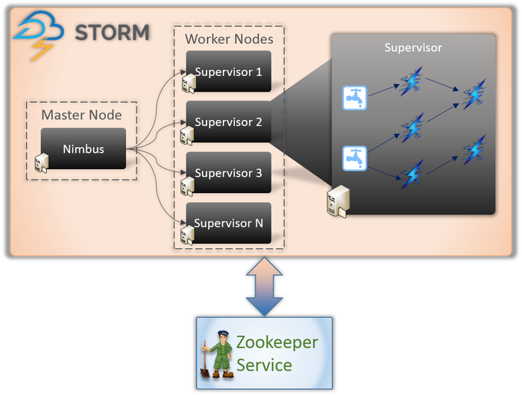
Limitations of Storm Worker Architecture
Complexity of Design: complex design, with multiple levels of scheduling and interactions between threads, leading to uncertainty about task scheduling.
Disparate Tasks in Workers: Kafka spout, internal service interaction, output writing) can run in the same JVM, making it challenging to isolate resource usage and troubleshoot issues.
Impact of Errors :Errors in one task can take down the entire worker process, impacting the performance of other tasks and leading to high variance in overall performance.
Inefficient Resource Allocation: Storm assumes homogeneous workers, resulting in inefficient resource utilization and over-provisioning, especially when diverse components are packed into a worker.
the limitations associated with the Storm worker architecture, emphasizing complexities in design, resource inefficiencies, error impacts, and scalability challenges. These insights underscore the necessity for developing Issues with Storm Nimbus

Slide 6

Issues with Storm Nimbus
Overloading
Storm Nimbus can become overloaded when processing a high volume of large data , scheduling , managing counter of topologies leading to performance degradation and delays in data processing.
Limitations due to Zookeeper
Storm Nimbus relies heavily on Zookeeper for coordination and metadata management, which can introduce additional complexity and potential points of failure.
Lack of Resource Isolation
Storm Nimbus does not provide sufficient resource isolation, which can result in resource contention and impact the overall stability and performance of the system.
Single Point of Failure
Storm Nimbus is a single point of failure in the Storm cluster, as the loss of Nimbus can result in the loss of metadata and disrupt the entire system.

Slide 7
Challenges in Storm
Lack of Backpressure :
Storm lacks a backpressure mechanism, resulting in unbounded tuple drops when the receiver component is overwhelmed
Disadvantages include:
Unbounded tuple drops without acknowledgements, leading to visibility issues.
Loss of upstream work.
Decreased system predictability and resource utilization.
2. Efficiency Concerns
Unpredictable performance during topology execution in production, leading to tuple failures, replays, and execution lag.
Common causes:
Suboptimal tuple replays, especially in high fan-out topologies.
Long garbage collection cycles due to large RAM consumption.
Queue contention, particularly when workers run multiple executors.
3. Overprovisioning for Mitigation
To mitigate risks, overprovisioning of resources is often necessary.
Example: A sample three-stage Storm topology requires 600 cores with only 20-30% CPU utilization on average.

Slide 8
Alternatives Considered
Apache Samza
Apache Samza is a distributed stream processing framework that provides fault tolerance and scalability.
However, it lacks the performance and manageability features required to address the limitations of Storm.
Apache Flink
Apache Flink is a powerful stream processing framework that offers low-latency processing and fault tolerance.
However, it does not provide the same level of scalability and manageability as Twitter Heron.
Apache Kafka Streams
Apache Kafka Streams is a library for building streaming applications that leverage Kafka as the underlying storage system.
However, it does not offer the same level of scalability and performance as Twitter Heron.
Apache Spark Streaming
Apache Spark Streaming is a real-time processing framework that integrates with the Spark ecosystem.
However, it does not provide the same level of fault tolerance and manageability as Twitter Heron.

Slide 9
Heron Design
Heron is a stream processing system designed to address the limitations of Storm and provide better scalability, performance, and manageability. It features a distributed, pluggable, and multi-language architecture, which enables it to handle large-scale data processing tasks efficiently.
Distributed Architecture
Pluggable Architecture
Multi-Language Support
Heron uses a distributed architecture to process streams of data in parallel across multiple nodes. This allows for high throughput and low latency processing, making it suitable for real-time data processing applications.
Heron's pluggable architecture allows users to customize and extend its functionality through the use of different components, such as spouts and bolts. This flexibility enables developers to build complex data processing pipelines tailored to their specific requirements.
Heron supports multiple programming languages, including Java, Python, and C++, allowing developers to write stream processing applications in their preferred language. This language-agnostic design makes it accessible to a wide range of developers
Key Features
Single-Task Processes: Heron introduces the concept of single-task processes, which allows for fine-grained resource allocation and efficient utilization of computing resources.
Resource Isolation: Heron provides resource isolation, ensuring that individual processes do not impact the performance of others. This enables better scalability and fault tolerance.
API Compatibility with Storm: Heron is designed to be compatible with the Storm API, making it easy for developers familiar with Storm to migrate their existing applications to Heron.

Slide 10
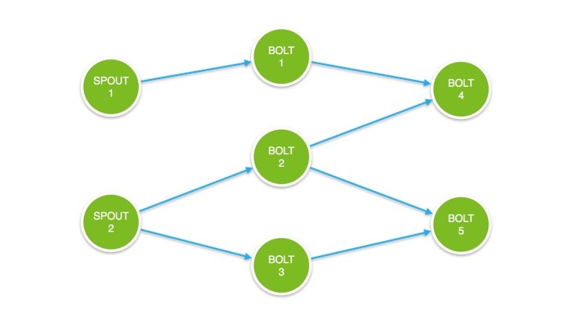

Startup Sequence
The startup sequence of Heron involves several steps performed by the topology master, stream managers, and Heron instances. Here is an overview of the startup sequence:
Topology Master Initialization: The topology master initializes and coordinates the execution of the Heron topology.
Stream Managers Startup: The stream managers start up and register themselves with the topology master. They are responsible for managing the data flow between the spouts and bolts.
Heron Instances Startup: The Heron instances, which include spouts and bolts, start up and register themselves with the stream managers. They are responsible for processing the data and executing the logic defined in the topology.
Data Flow Initialization: Once all the Heron instances are started, the stream managers establish the data flow between the spouts and bolts, ensuring that the data is processed correctly.

Slide 11
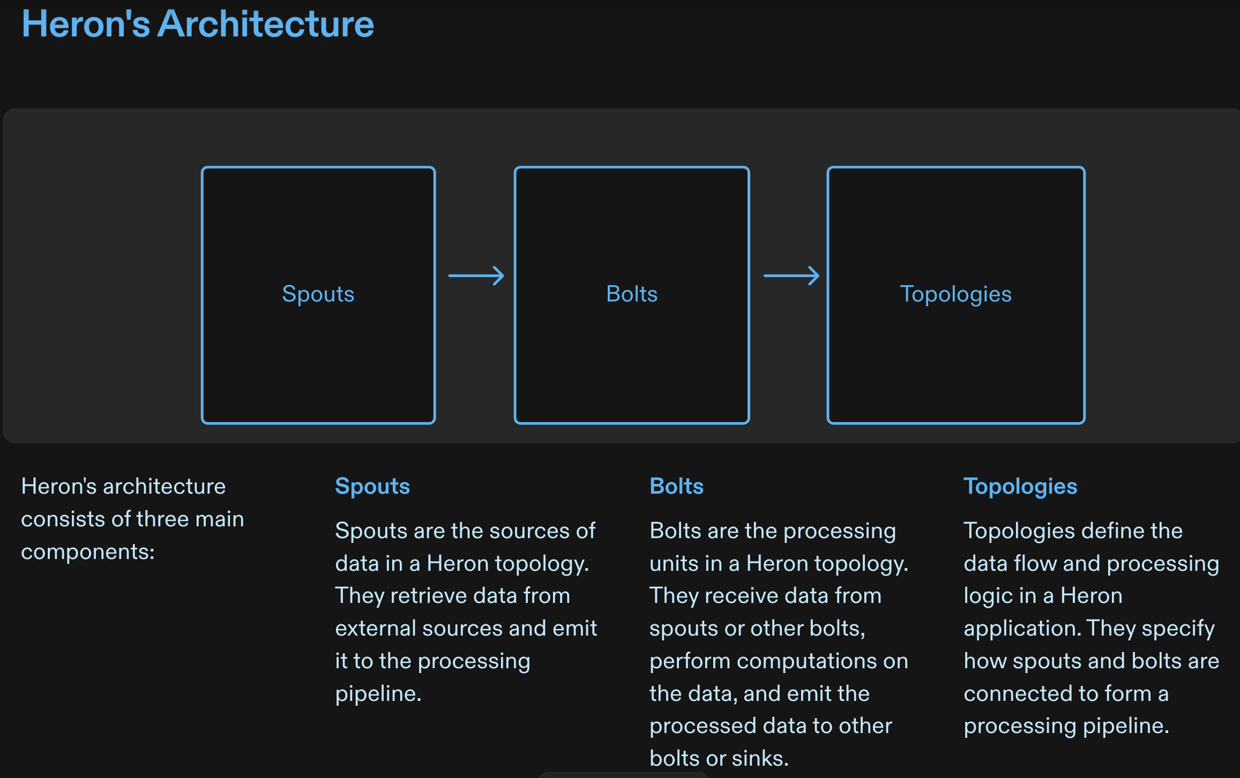
Heron's Architecture
Heron's architecture consists of three main components:
Spouts
Spouts are the sources of data in a Heron topology. They retrieve data from external sources and emit it to the processing pipeline.
Bolts
Bolts are the processing units in a Heron topology. They receive data from spouts or other bolts, perform computations on the data, and emit the processed data to other bolts or sinks.
Topologies
Topologies define the data flow and processing logic in a Heron application. They specify how spouts and bolts are connected to form a processing pipeline.

Slide 12
Heron Tools
Metrics Manager
Metrics Manager is a tool used with Heron to collect and store metrics data from running topologies. It provides insights into the performance and behavior of the system.
Heron UI
Heron UI is a web-based user interface that allows users to monitor and manage their Heron topologies. It provides real-time information about the status of topologies, resource utilization, and performance metrics.
Heron Viz
Heron Viz is a visualization tool that helps users understand the flow of data and the behavior of their topologies. It provides visual representations of the data flow and allows users to analyze and debug their topologies.
Aurora
Aurora is a management and monitoring tool for Heron. It provides centralized control and monitoring of Heron clusters, allowing users to manage and scale their topologies efficiently.

Slide 13
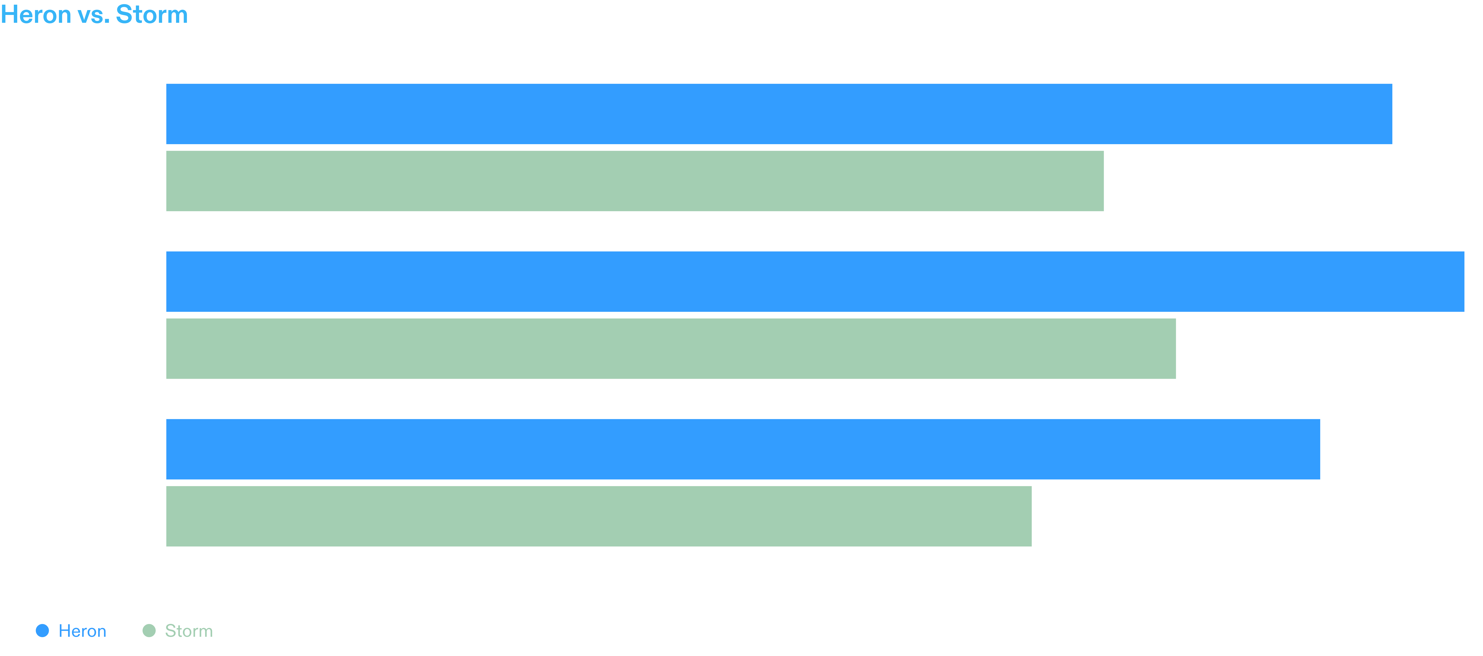
Word Count Topology Evaluation
Heron vs. Storm
Heron, a stream processing system, offers significant improvements in throughput, latency, and CPU usage compared to Storm.
The word count topology in Heron demonstrates the enhanced performance and efficiency of the system

Slide 14
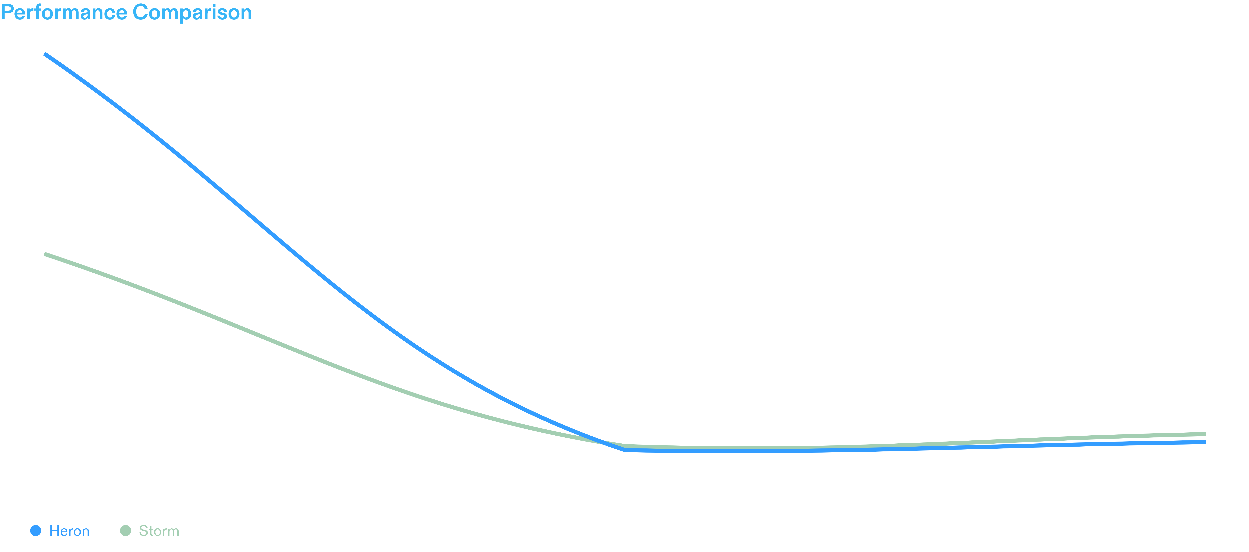
Heron Evaluation

Slide 15
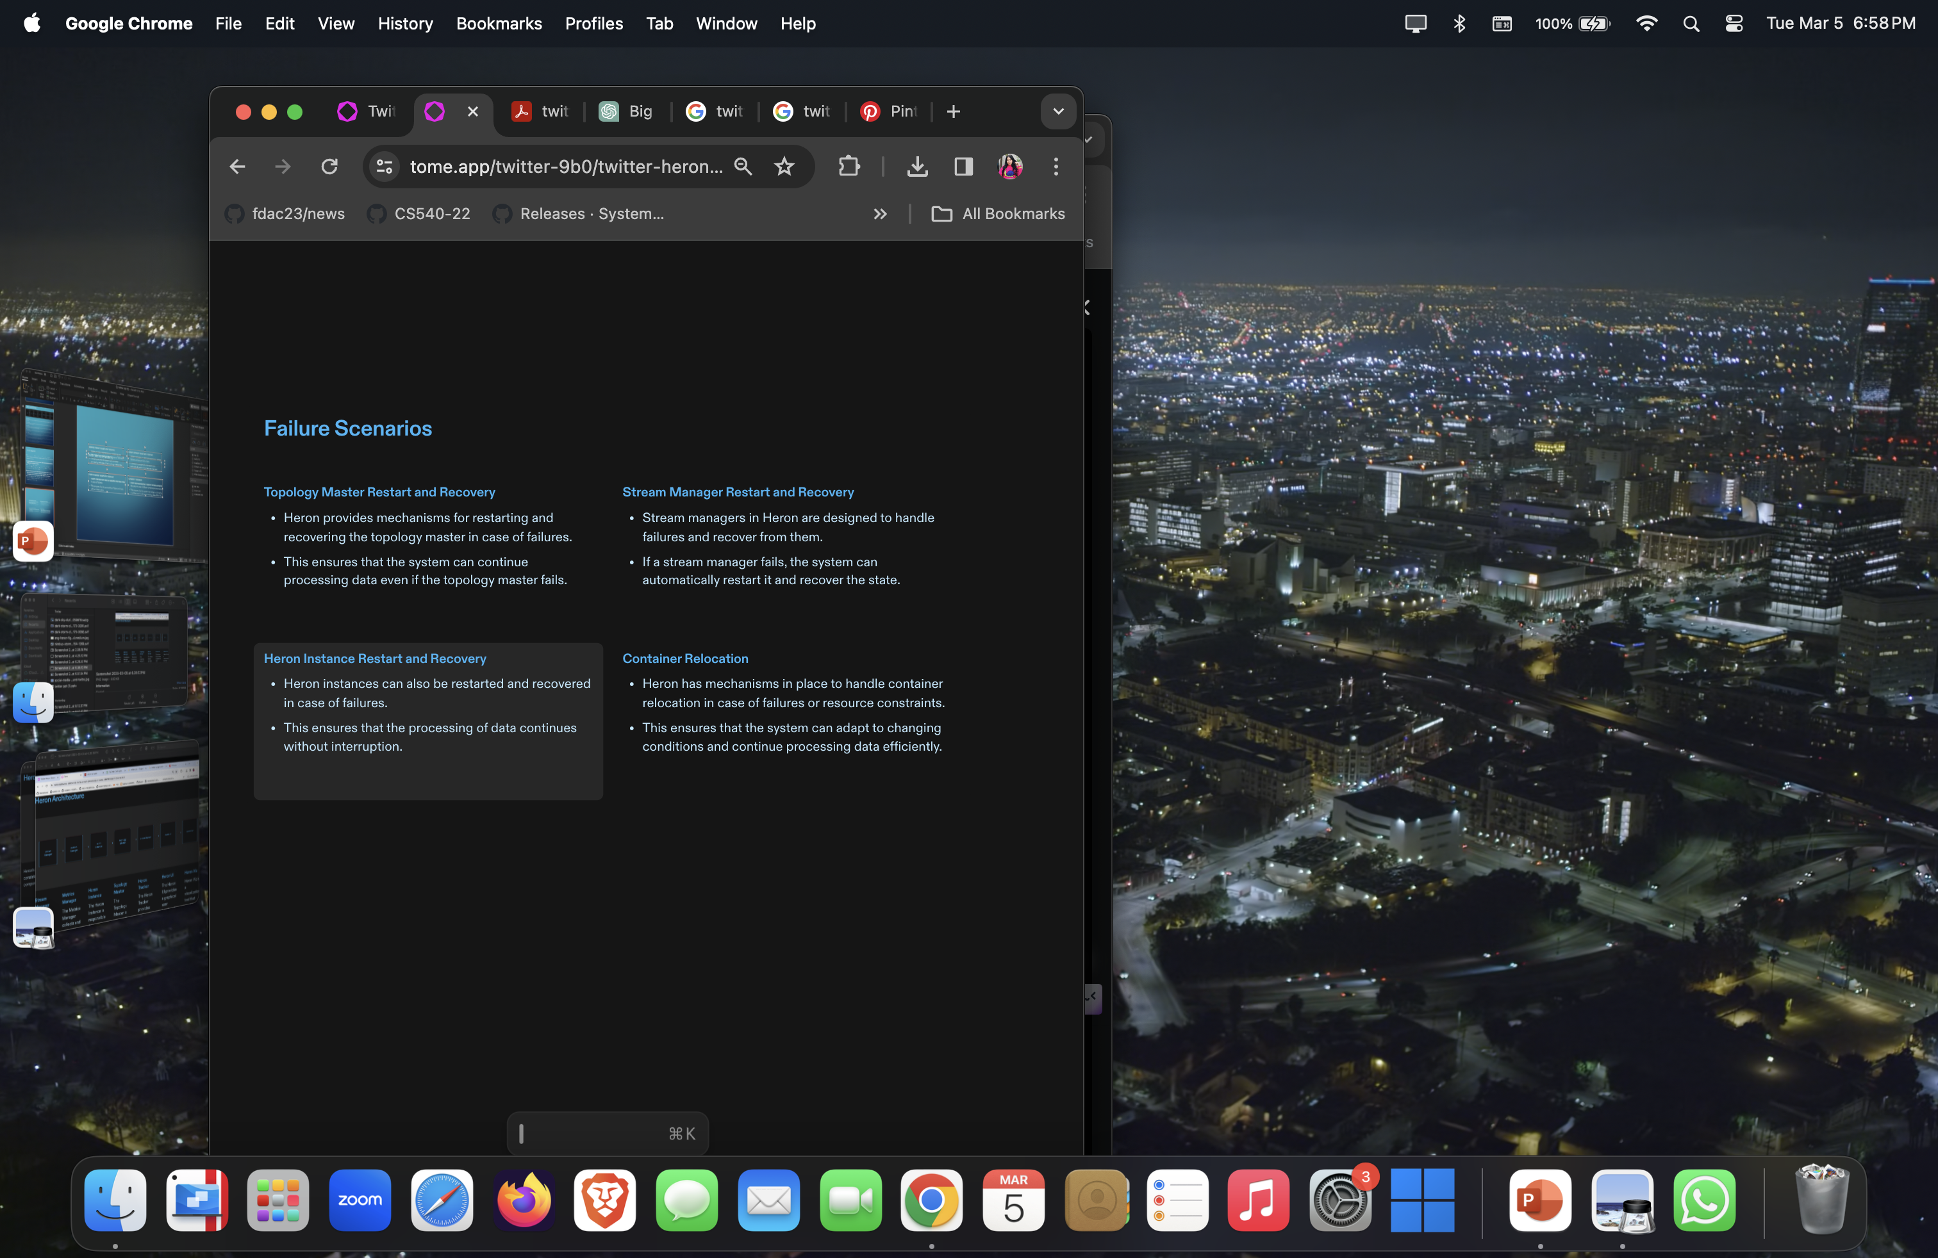

Slide 16
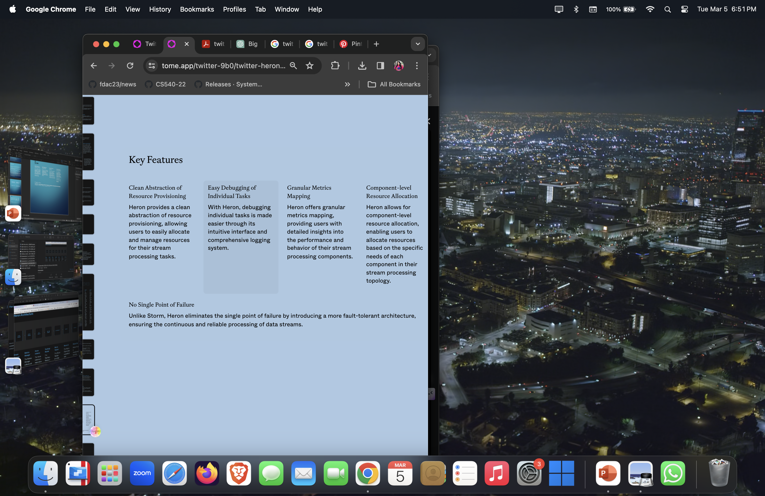

Slide 17

Case Studies/Use Cases
Real-time Analytics
Heron enables Twitter to process and analyze millions of tweets per second in real-time, providing valuable insights for trending topics, sentiment analysis, and user behavior.
Fraud Detection
By leveraging Heron's high-throughput and low-latency processing capabilities, Twitter can detect and respond to fraudulent activities, such as spam accounts and fake news, in real-time.
Personalized Recommendations
Heron powers Twitter's recommendation system, delivering personalized content to users based on their interests, preferences, and social connections.
Trend Prediction
With Heron, Twitter can identify emerging trends and predict their future popularity, allowing users and businesses to stay ahead of the curve in terms of content creation and marketing strategies.

Slide 18
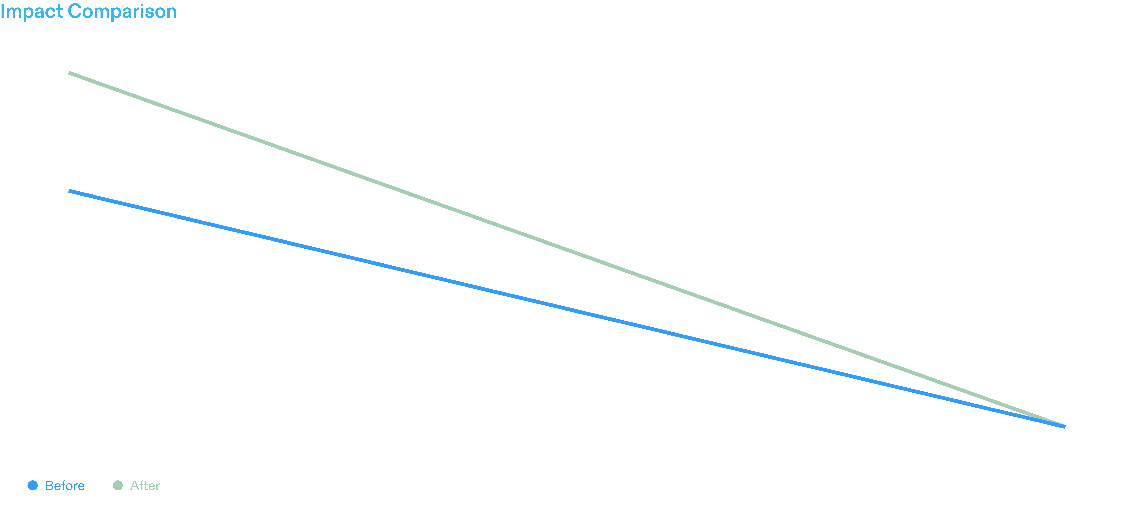
Impact

Slide 19
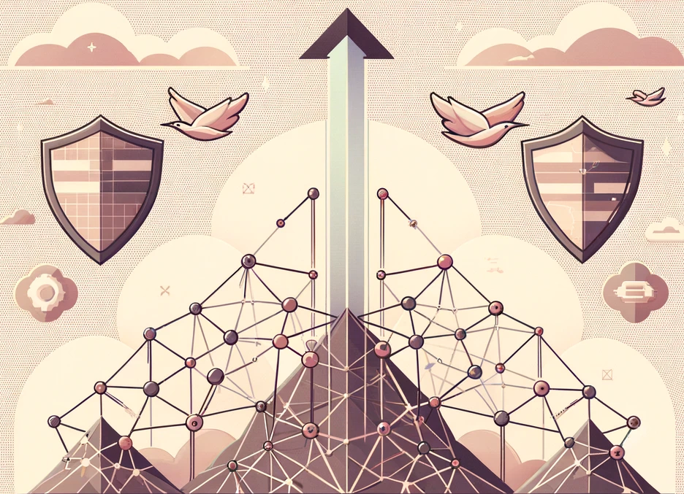

Conclusions and Future Work
Conclusion
Twitter Heron is a powerful stream processing system designed to handle large-scale data processing.
Its architecture is based on the concept of topology and provides fault tolerance and scalability.
Key features of Heron include high throughput, low latency, and support for multiple programming languages.
Heron has had a significant impact on Twitter's ability to process and analyze real-time data.
The Future of Stream Processing
As the volume and velocity of data continue to increase, the demand for stream processing technologies like Heron will only grow.
The future of stream processing lies in the development of more efficient and scalable systems that can handle even larger data streams.
In the coming years, we can expect to see advancements in areas such as real-time analytics, machine learning, and event-driven architectures.

